Slide 1
PRESENTATION ON PROJECT
SUB Course Registration Form
Supervised by:
Khan Md. Hasib
Lecturer, Presented by:
CSE Department. Taskir Rahman Tasin
State University of Bangladesh UG02-48-18-007

Slide 2
Contents
1.Introduction of topic
2.Feasibility Analysis
3. Minimum Requirement
4.Index Terms
5.PROPOSED METHODOLOGY
6.System Design
7.Project Picture
8. Advantages
7.Conclusion

Slide 3
Introduction of Topic
Student course registration are a vital part of any university’s . A poor course registration system can mean fever student being take course in a new semester because of mistake or an overly slow response time. Student course registration is the project which is helpful for student and as the department . In this project the student facilitated by taking courses, implement their installment payment information and input their personal information . Online Registration system will allow online submission of student application, Student Registration. Student Information system will store all the details of the students including their background information, educational qualifications, personal details and all the information related to their resume.
Through this system we overcome many problems.
1.Time and money saved.
2.Nothing to done manually..

Slide 4
Feasibility Analysis
This project system was developed where a student can register himself. The registration form has been designed to be user friendly and easy to fill by the students. The project can be undertaken with available technology and resources.

Slide 5
Minimum Requirement
Hardware Requirements:
Pentium-III Processor with 512 MB RAM
Screen resolution viewing of at least 800*600 is required for proper and complete viewing of screens. Higher resolution will be accepted.
Software Requirements:
Operating system:- Windows XP/7/8.1/10
Application Software:- XAMPP, notepad++

Slide 6
Index Terms
MySQL: MySQL is a RDBMS based on SQL which is used for adding, removing and modifying information in the database.
RDBMS: Relational Database Management System
HTML: Hypertext Markup Language is use to create interface element.
PHP: Hypertext Preprocessor
CSS: Cascading Style Sheet

Slide 7
PROPOSED METHODOLOGY
SUB Student registration System is software which is helpful for students as well as the school authorities. Proposed online student registration system will eliminate all the manual intervention and increase the speed of whole process. In our proposed system we have the provision for adding the details of the students by themselves. So the overhead of the university authorities and the teachers is become less. The objective of Student registration System is to allow the advisor of any organization to edit and find out the personal details of a student and allows the student to keep up to date his profile. This student information and registration management system project mainly explains the various actions related to student details. System will allow student to fill the form online, system has inbuilt validation system to validate the entered data. It’ll also facilitate keeping all the records of students, such as their id, name, mailing address, phone number etc. So all the information about an student will be available in a few seconds. After successful submission, system will give no unique registration for each student. Student can login into system by using registration. System will show the result after instantly and stored the results. Overall, it’ll make Student registration Management an easier job for the advisor and the student of any organization.

Slide 8
Cont.
After analysis the requirement we decide that we need to create following web pages: State University of Bangladesh page , Home Page, About US page Student Login Page , Registration Form ,Advisor list , class schedule Dept. of CSE, Batch wise Offered course list , List of Offered course , Academic calendar , Advisor login page, Contact Us. There are two different users who will be using this product:
Advisor
Student

Slide 9
Cont.
Input
Process
The following are needed as input within the system:
1.Student User ID and password. 2.The Student details which include name, banking details , course details, and all student details required for registration.
3.The Advisor’s email and password
The system will be carrying out the following processes:
Storage of student’s details into the database.
Storage of the Advisor’s details.
Creating audit trails and tracking all session as on logs in and out.

Slide 10
Cont.
Output
Sending text notification and email notifications of the registration status to the student.
Display relevant details to the advisor’s.
Notify via text and email to the student that the registration is complete

Slide 11
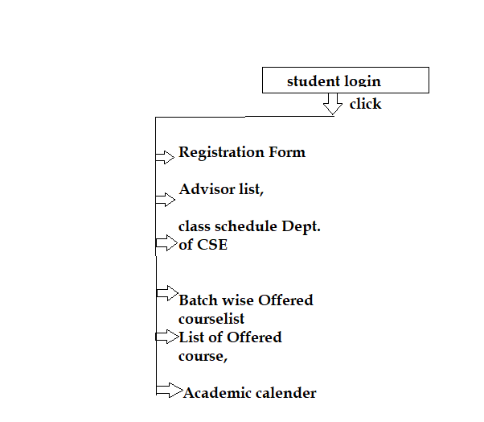
System Design(Student Login)
Student Login - Each student would need a login user ID and password.
The students should be able to input their courses for the semester and also see their course information . The students should be able to input their personal details, banking details . The student be able to logout his /her profile

Slide 12
System Design(Advisor Login)
Advisor Login – Advisor would need a unique login user email and password
1.The advisor should be able to view the student’s personal details, banking details , and number of course have been taken by students.
2.The advisor should be able to approve or disapprove the student’s registration.
3.Advisor View the list of those registered students.
4.Advisor should be able to view from the back end. Should be able to add new users and activate/deactivate user profiles
5.Update user profiles.
6.Should have access to all system components.

Slide 13
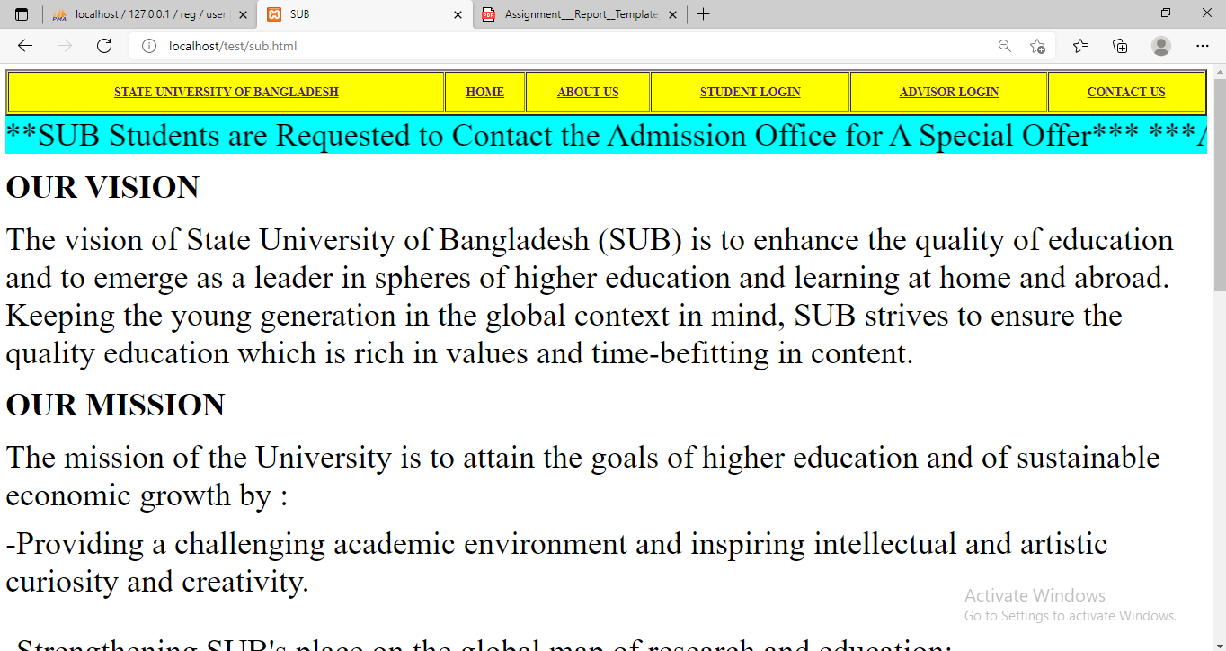
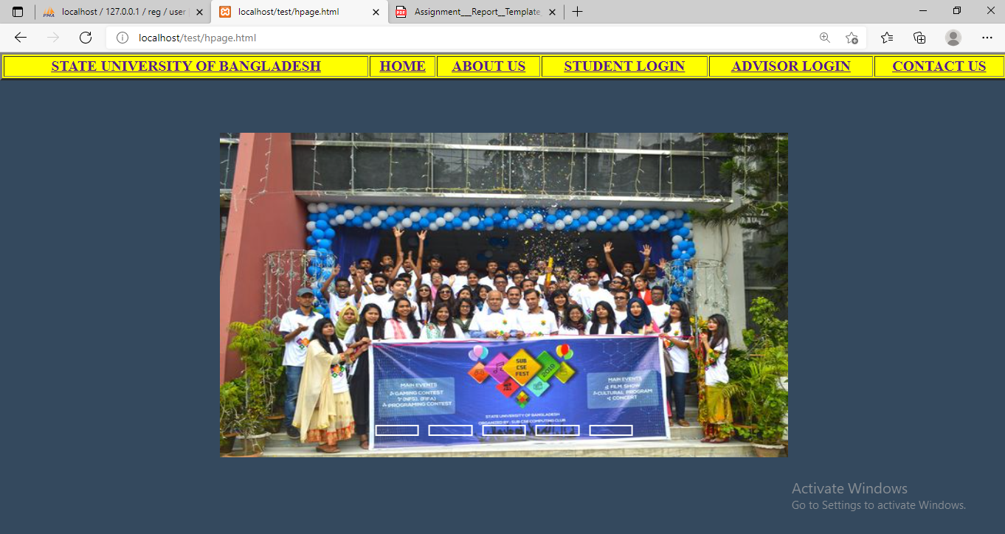
Project pictures
state University of Bangladesh page
Home page

Slide 14
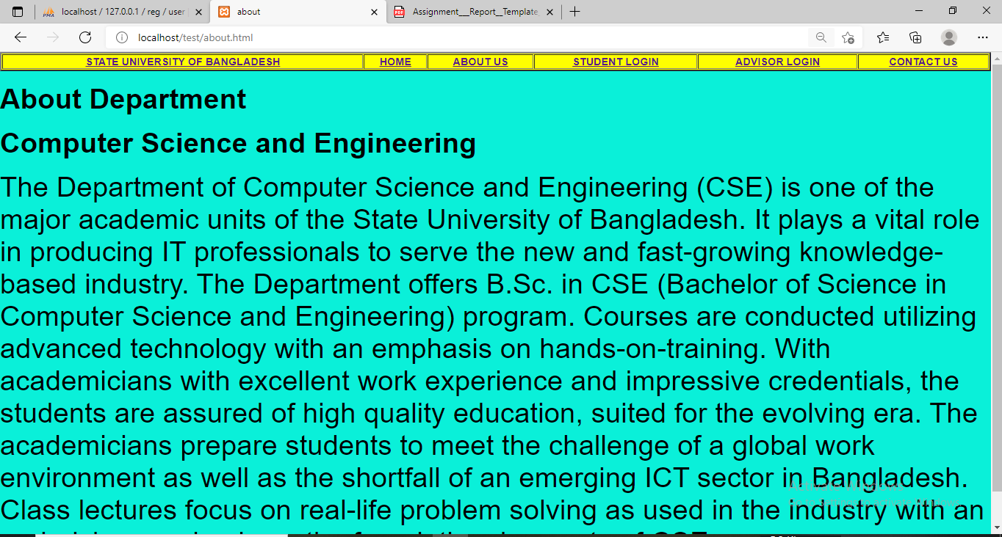
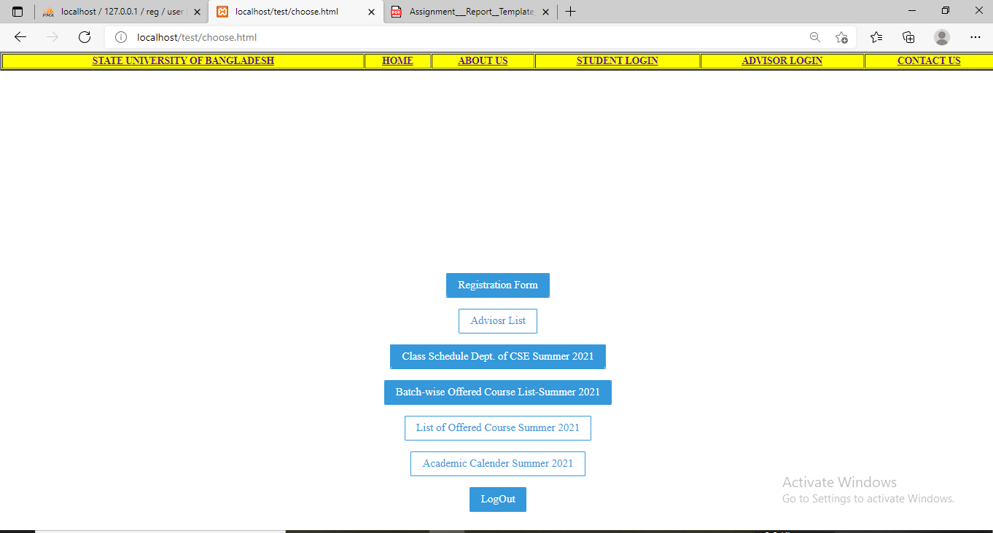
Project pictures
About US page
Student Login page

Slide 15
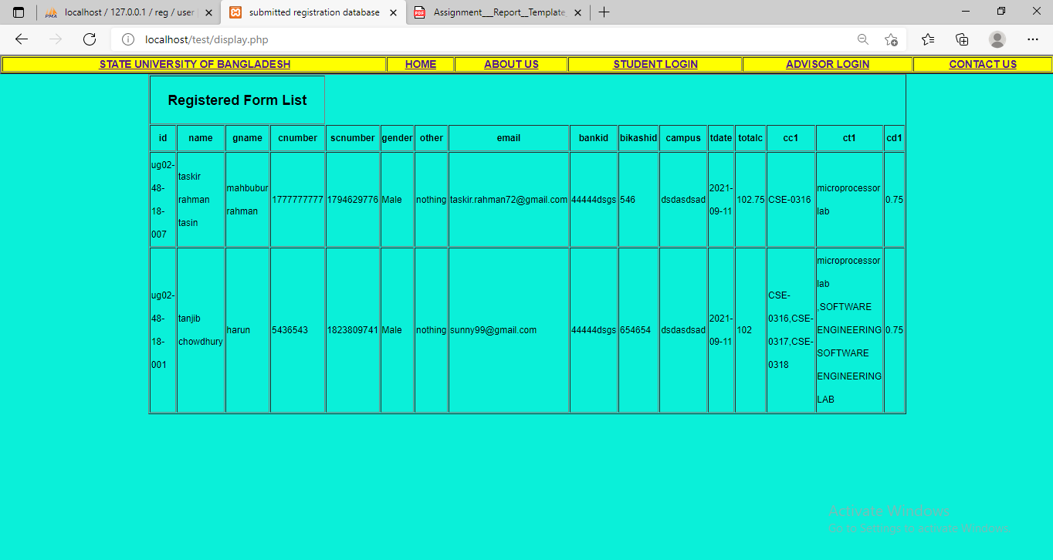
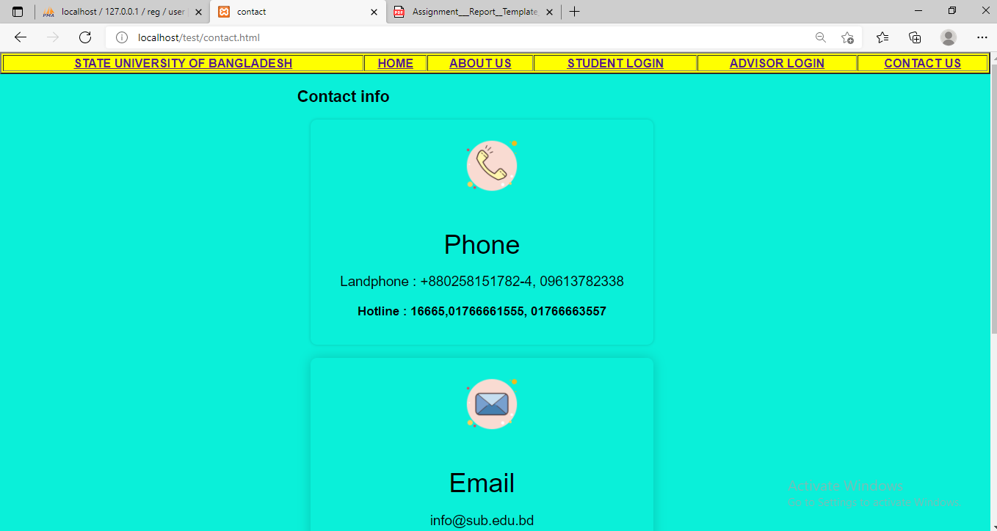
Project pictures
Advisor Login page
Contact us page

Slide 16
Advantages
1.Used to maintain the records of students easily.
2.It also provides a less time consuming process for viewing, adding, editing the marks of the students.
3.The project provides facilities like online registration and profile creation of students thus reducing paperwork and automating the record generation process in an educational institution.

Slide 17
Conclusion
This project was developed keeping in mind the functionalities for students and advisors. This project provides all the functionalities specified in the project document. I tried to simulate the real world environment by generating loads of data from the university itself. Much functionalities can be added over the existing one so that the system has more enhanced features and its more efficient.

Slide 18
Thank you

